Slide 1
Threads, SMP, and MicroKernels
Supplemental Material Chapter 4
CS 3100
Richard Fry, PhD
Department of Computer Science
Weber State University

Slide 2
Recall Process Characteristics
Unit of resource ownership – a process is allocated.
  The OS uses a virtual address space to hold process image containing the PCB.
  It controls some resources (files, I/O devices...)
Unit of execution - process is an execution path (trace) through one or more programs
  execution may be interleaved with other processes
  the process has an execution state and a priority

Slide 3
Process Characteristics
These 2 characteristics are treated independently by some modern OS
The unit of resource ownership is usually referred to as the process or task, itself.
The unit of execution is usually referred to as a thread.

Slide 4
Threads
Therefore, Threads are a subdivision of processes!
Since there is less information associated with a thread than there is info associated with a process, thread switching is more efficient than process switching.

Slide 5
Single threading vs. Multithreading
Single threading: processes are not subdivided in threads (Process and Thread interchangeable terms)
  MS-DOS supports a single user process and a single thread
Multithreading: processes are subdivided in threads
  Traditional UNIX supports multiple user processes, but only supports one thread per process
  Solaris, Linux, Windows Vista (and higher), OS/2 support multiple threads and multiple processes

Slide 6
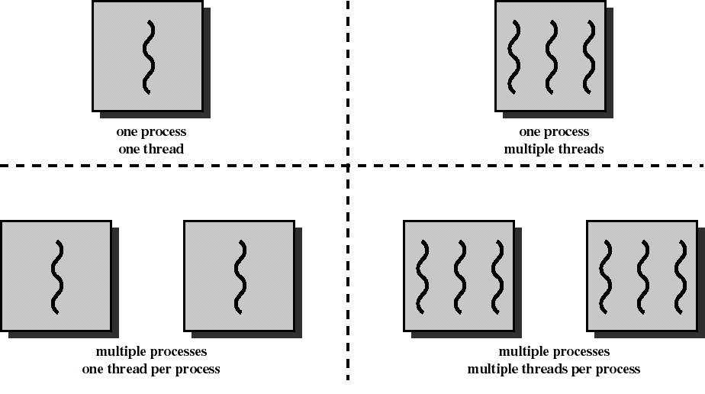
Processes and Threads

Slide 7
Remember, Processes…
Have a virtual address space which holds the process image
This image has protected access to processors, other processes, files, and I/O resources (remember the process control block?)

Slide 8
Threads, like processes…
Have execution states (running, waiting, ready, etc.)
Their context is saved when not running
They have private storage for local variables and an execution stack…BUT, unlike Processes, threads
  Have shared access to the address space and resources (files…) of their process
  when one thread alters (non-private) data, all other threads (of the process) can see this
  threads communicate via shared variables
  a file opened by one thread is available to others

Slide 9
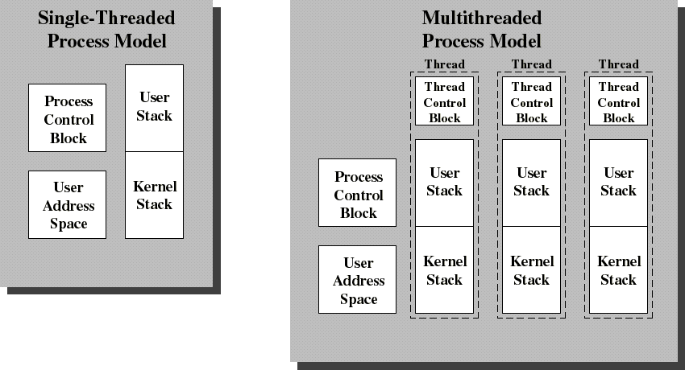
Single Threaded and Multithreaded Process Models
Thread Control Block (TCB) contains a register image, thread priority and
thread state information (compare with PCB diagram last lecture)

Slide 10
Benefits of Threads vs. Processes
Responsiveness
  Allows a program to continue running, even if part of it is blocked
Resource Sharing
  By default threads share same memory and resources as parent
Scalability
  In Symmetric Multiprocessing: different threads can possibly execute simultaneously on different processors

Slide 11
Benefits of Threads vs. Processes
Economy
  It takes less time to create a new thread than a new process
  Less time to terminate a thread than a process
  Less time to switch between two threads within the same process than to switch between processes
    Mainly because a thread is associated with less information.
    Less overhead.

Slide 12
Benefits of Threads
Example: a file server on a LAN or Web Server
It needs to handle several file requests over a short period
Hence more efficient to create (and destroy) a single thread for each request
Such threads share files and variables
Consider the alternative: Multiple Processes
  More overhead
  Less efficient

Slide 13
Application benefits of threads
Consider an application that consists of several independent parts that do not need to run in sequence (MS-Word)
Each part can be implemented as a thread
Example: one thread displays menu and reads user input while the other thread executes user commands, and another performs the spell check.
Whenever one thread is blocked waiting for an I/O, execution could possibly switch to another thread of the same application (instead of switching to another process entirely)

Slide 14
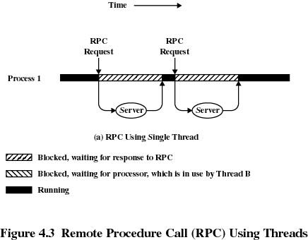
Remote Procedure Call Using one thread (single process) only

Slide 15
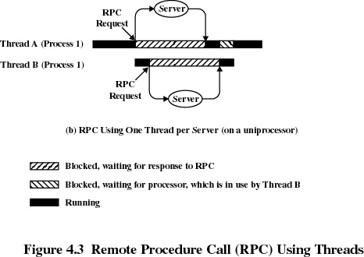
Remote Procedure Call Using Multiple Threads:
less waiting time

Slide 16
Benefits of Threads
Since threads within the same process share memory and files, they can communicate with each other without invoking the kernel
However, it’s necessary to synchronize the activities of various threads so that they do not obtain inconsistent views of the data (next lecture – Chapter 5)

Slide 17
Suspending and Terminating
Suspending a process involves suspending all threads of the process
Termination of a process terminates all threads within the process
  This is because threads share the same address space in the process!
    Parent – Child

Slide 18
Threads States
Like processes, four key states: ready, running, blocked (waiting), and terminated (exit).
New is automatic state when the thread is Spawned (or created with Fork command).
Windows adds standby and transition states.
Note: Thread states are maintained INDEPENDENT of the process state.
  A thread may still be in a running state (well, sort of), while it’s process is blocked

Slide 19
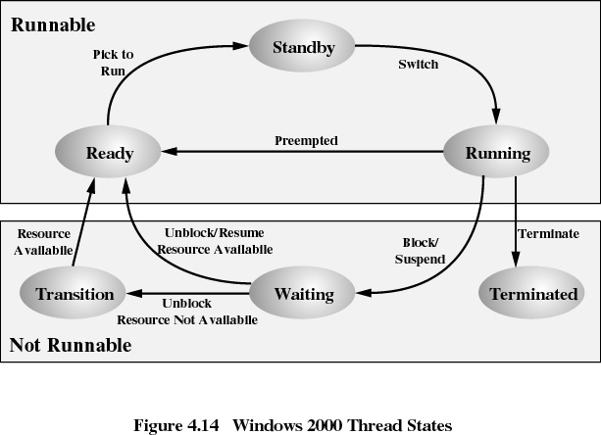

Slide 20
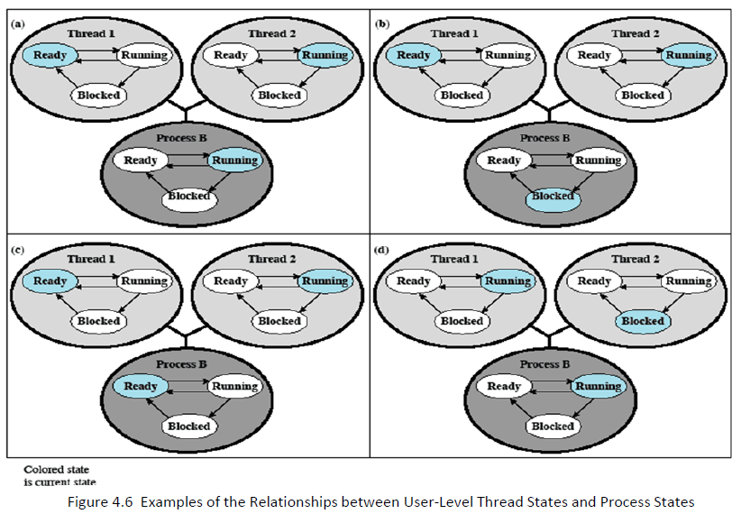

Example of Thread and Process States

Slide 21
Thread management
Thread management can be done in one of three fundamental ways:
  User-level threads: threads are entirely managed by the application
  Kernel-level threads: threads are entirely managed by the OS kernel
  Combined approaches

Slide 22
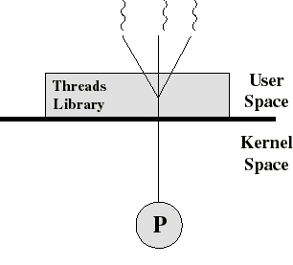
User-Level Threads (ULT) (ex. Standard UNIX)
The kernel is not aware of the existence of threads
All thread management is done by the application using a thread library
Thread switching does not require kernel mode privileges (no mode switch)
Scheduling is application specific

Slide 23
Threads library
Contains code for:
  creating and destroying threads
  passing messages and data between threads
  scheduling thread execution
  saving and restoring thread contexts
  User libraries covered in the book, include POSIX’s Pthreads, Win 32 Threads, and Java.
    Note: JAVA threads are different when it comes to sharing data – as there is no concept of declaring data globally.

Slide 24
Kernel activity for ULTs
The kernel is not aware of thread activity, but it still manages process activity
When a thread makes a system call, the whole process is blocked
But for the thread library that thread is still in running state
So, again, thread states are independent of process states!

Slide 25
Advantages and disadvantages of ULT
Advantages
  Thread switching does not involve the kernel: no mode switching
  Scheduling can be application specific: choose the best algorithm.
  Can run on any OS. Only needs a thread library
Disadvantages
  Most system calls are blocking for processes. So all threads within a process will be blocked, unless you use “jacketing”.
  The kernel can only assign processes to processors. Two threads within the same process cannot run simultaneously on two processors.

Slide 26
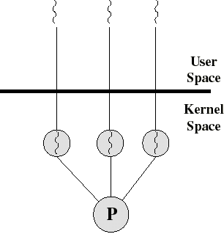
Kernel-Level Threads (KLT)
Ex: Windows Vista (and higher), Linux and OS/2
All thread management is done by kernel
No thread library but an API to the kernel thread facility
Kernel maintains context information for the process and the threads
Switching between threads requires the kernel
Scheduling on a thread basis

Slide 27
Advantages and disadvantages of KLT
Advantages
  the kernel can simultaneously schedule many threads of the same process on many processors (or cores)
  blocking is done on a thread level
  kernel routines can be multi-threaded
Inconveniences
  thread switching within the same process involves the kernel. We have 2 mode switches per thread switch
  this may result in a significant slow down
  however kernel may be able to switch threads quicker than user’s lib

Slide 28
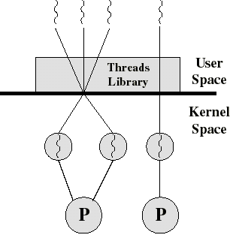
Combined ULT/KLT Approaches (Solaris)
Thread creation done in the user space
Bulk of scheduling and synchronization of threads done in the user space
The programmer may adjust the number of KLTs
Combines the best of both approaches

Slide 29
Solaris
Process includes the user’s address space, stack, and process control block
User-level threads (threads library)
  invisible to the OS
  are the interface for application parallelism
Kernel threads
  the unit that can be dispatched on a processor
Lightweight processes (LWP)
  each LWP supports one or more ULTs and maps to exactly one KLT
  LWPs are visible to applications
  therefore LWP are the way the user sees the KLT
  constitute a sort of ’virtual CPU’

Slide 30
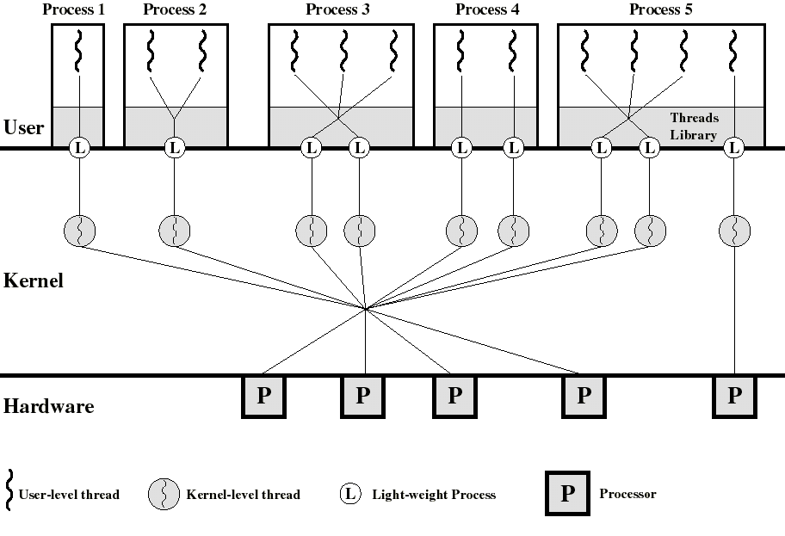

Slide 31
Solaris: The key is versatility
We can use ULTs when logical parallelism does not need to be supported by hardware parallelism (we save mode switching)
  Ex: Multiple windows but only one is active at any one time
If ULT threads can block then we can add two or more LWPs to avoid blocking the whole application
Note versatility of SOLARIS that can operate like Windows or like conventional Unix

Slide 32
Symmetric Multiprocessing (SMP)
Kernel can execute on any processor
Typically each processor does self-scheduling form the pool of available process or threads

Slide 33
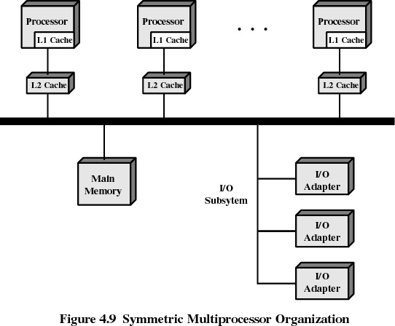

Slide 34
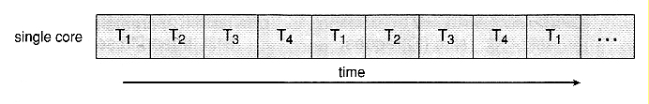
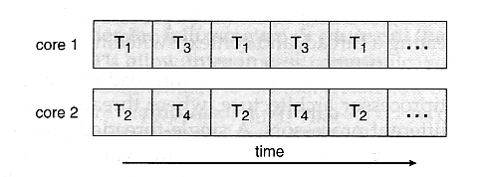
Multi-Core CPU’s
Beyond simple interleaving (shown below) slides).
Threads can now be programmed to run on the same CPU simultaneously in parallel.

